Slide 1
CS2030 Lab 2
AY22/23 Sem 2

Slide 2
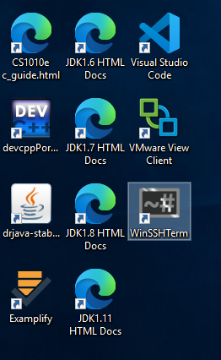
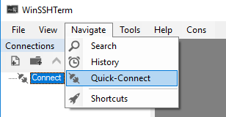
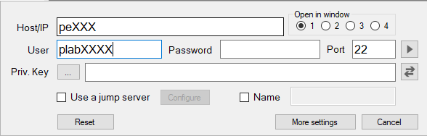
Admin Matters
Please log in to the PE node first!

Slide 3
Self Exercise 1 Recap - Imports
import java.lang.*;
Note that these libraries are automatically imported!
As a result, you do not need to import them in your java file.
Notable libraries (java API):
java.lang.Math;
java.lang.Integer;
java.lang.Boolean;
...

Slide 4
Project Anti-Patterns/Malpractices
God object. If you have one class that does everything, you might want to ask yourself if you can delegate the jobs to other classes instead.
Remember to adhere to Single Responsibility Principle. This applies to methods as well.
Violating Tell-Don’t-Ask Principle. Having unnecessary getters are good indication of violating the principle. If you can get the class to do it for you, create a method in the class instead. Common violations:
Shop class calling getters in Server and Customer classes to check if server is free to serve the customer. Instead, a better design would be to tell Server class to check if Customer can be served.
Some getters are necessary, e.g. get() in ImList, or complex objects like Customer (getServiceTime() etc) will need getters to be functional

Slide 5
Feedback from Lab 1 - String formatting
String formatting for toString() method
Do not break up your String and use multiple String.format() to just convert int to your desired format
For example:
//Bad
return "point (" + String.format("%.3f", this.x) + ", " + String.format("%.3f", this.y) + ")";
//Good
return String.format(“point (%.3f., %.3f)”, this.x , this.y);

Slide 6
Feedback from Lab 1 - String formatting
Some common formats for String formatting, for your reference:
%d: Integer (inclusive of byte, short, int, long, bigint)
%(x).f: Float to (x) d.p.
%s: String, basically the toString() equivalent
for more format options, you can check this link: https://www.javatpoint.com/java-string-format

Slide 7
Feedback from Lab 1 - One Function, One Thing!
Logic in Shop’s toString() method:
Do not handle the logic in Shop’s toString() and use a helper function to handle the logic
Remember, toString() is also a function — its job is to print out the representation of the class’ instance!

Slide 8
Feedback from Lab 1 - One Function, One Thing!
For example:
//Bad
public String toString() {
String str = “”;
(logic…);
return str;
}
//Good
public String toString() {
return simulateShop(); //where simulateShop is a function that handles the logic in Lab 1
}

Slide 9
Lab 1 Recap - Style - Use of Spaces
Use spaces after operators and punctuation marks
Good | Bad
int x = 1 + 2; | int x=1+2;
String.format("%s", "hi"); | String.format("%s","hi");

Slide 10
Lab 1 Recap - Style - Variable Naming
Use more descriptive variable names
public class Customer {
private final double st; // Not advisable
private final double arrivalTime; // Better variable name
}
Spell out variables in full (e.g. nextAvailableTime instead of nat)
The convention in Java is to use camelCase instead of snake_case (helloWorld instead of hello_world)

Slide 11
Lab 1 Recap - Style - Variable Names
public class Customer {
private final double arrivalTime;
public Customer(double at) {
arrivalTime = at;
}
}
You do not need to give the arrivalTime that’s being passed into the constructor a different name just because the word arrivalTime has already been used to name the instance variable.
Just use arrivalTime instead of at and use the this keyword to differentiate between the two.
public class Customer {
private final double arrivalTime;
public Customer(double arrivalTime) {
this.arrivalTime = arrivalTime;
}
}

Slide 12
Lab 1 Recap - Style - if Statements
Use braces after single line if statements
// works but not advisable; could result in bugs if not careful
if (condition)
// code here;
// better
if (condition) {
// code here;
}

Slide 13
Lab 1 Recap - Style - Boolean Expressions
// Redundant if-else statement
if (booleanMethod(parameter) == true) { // if true == true???
return true;
} else {
return false;
}
// Better
return booleanMethod(parameter); // Just return the result

Slide 14
Lab 1 Recap - Style - Line Wrapping
Wrap lines instead of letting them get too long
It is usually appropriate to wrap lines after operators or at appropriate junctures for Strings (e.g. after a full-stop)

Slide 15
Lab 1 Recap - Style - String.format()
String.format() can be used to format entire strings instead of being called multiple times
The following lines return the same String (assume that id is int variable)
Use %s as the placeholder for a String
return "customer " + String.format("%d", id) + " left";
return String.format("customer %d left", id);

Slide 16
Lab 1 Recap - Style - Variable Initialization
Not recommended:
String name;
name = sc.nextLine();
Better (declare and initialize variables within the scope that they are needed):
String name = sc.nextLine(); // Declare and initialize here

Slide 17
Lab 1 Recap - Style - Variable Initialization
Not recommended:
int i, j, k;
for (i = 0; i < n; i++) {
for (j = 0; j < n; j++) {
// Other code
}
}
Better (declare and initialize variables within the scope that they are needed):
for (int i = 0; i < n; i++) { // i in the scope of this for loop
for (int j = 0; j < n; j++) { // j in the scope of this for loop
// Other code
}
}

Slide 18
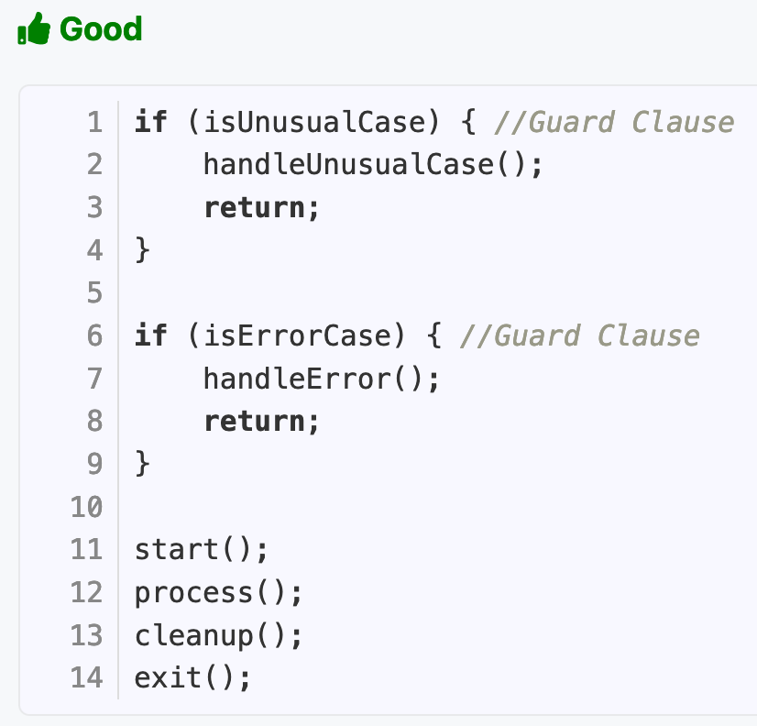
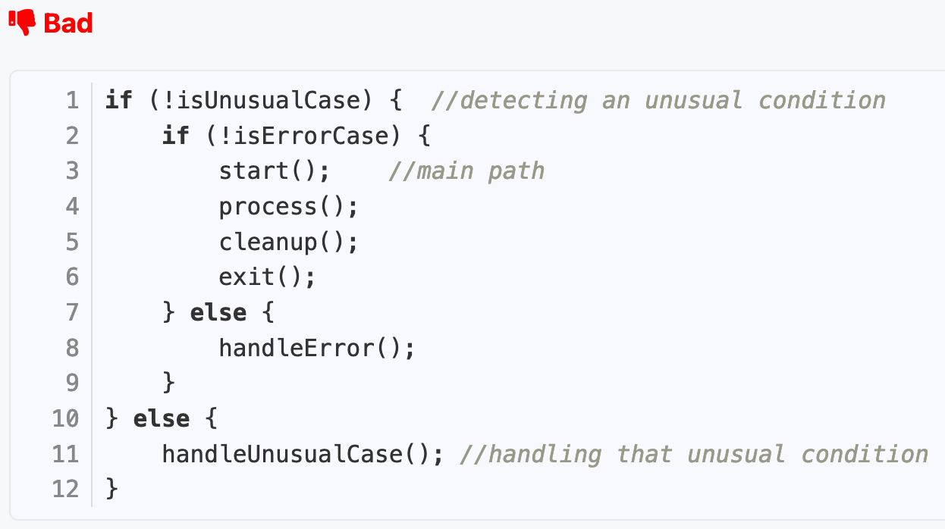
Lab 1 Recap - Style - Guard Clause

Slide 19
Lab 1 Recap - Style - CS2030 Style Guide
Original style guide:
https://nus-cs2030.github.io/1718-s2/style/index.html
Github Wiki:
https://github.com/nus-cs2030/2223-s2/wiki/Java-Style-Guide
Setup CheckStyle on Docker: https://github.com/nus-cs2030/2223-s2/wiki/Setting-Up-CheckStyle

Slide 20
Concepts used in Lab 1

Slide 21
Static Keyword
The static keyword is used to declare class level attributes
What’s the difference between class level attributes and instance attributes?
Every instance of a class will have the same shared attribute whereas instance attributes are specific to the instance itself

Slide 22
Concepts Used in Lab 1
Abstraction/Modularization
Break up long method implementations into multiple smaller methods.
Do not dump everything into one method.
If needed, you can abstract out long lines of code into helper functions.
This will help you when it comes to debugging and is important in writing code with good design.
Data Hiding
Always declare class and instance variables as private (except for special cases like constants)
This is to hide implementation details from users and clients.
This is part of encapsulation whereby only classes and instances that need to know about the data will have access to them.

Slide 23
Concepts Used in Lab 1
Immutability
Make objects immutable so that they cannot be tampered with, and the internal state of the object will stay constant throughout the program
Important for debugging! (Remember, effect-free…)
especially important for reference types (non-primitive data types such as classes and arrays)
Use the final keyword for instance variables and use constructors to get new object instances
e.g. Customer setX(double x) method. Does not modify x, but creates a new customer with value x.
No modifying instance variables!
e.g. a void setX(double x) method), that directly modifies this.x!
We do not change the state of immutable objects once they are created.

Slide 24
Lab 1 Recap - Concepts - Abstraction/Modularisation
Example of modularisation:
public class Server {
...
boolean canServe(double arrivalTime) {
return nextAvailableTime <= arrivalTime;
}
}
You can make use of the above method as necessary instead of repeatedly calling nextAvailableTime <= arrivalTime;.

Slide 25
Inheritance/Subclassing
A class can be derived from other classes. This establishes an IS-A relationship between the inherited class and the class itself
The subclass will be able to reuse the fields and methods of the inherited class without having to rewrite them
Any method which accepts an object of parent class will also allow an object of child class (Form of Polymorphism)

Slide 26
Inheritance/Subclassing
A
int compute()
extends
B
B (by subclassing A) implicitly has access to all non-private attributes and methods in A

Slide 27
Inheritance/Subclassing
class A {
private final int num;
A(int num) {
this.num = num;
}
int compute() {
return num + num;
}
}
class B extends A {
B(int num) {
super(num); //uses A’s constructor to initialize num
}
@Override
int compute() {
/*
Note that simply calling compute() instead of super.compute() will recursively call B's compute() and the program will eventually crash
*/
return super.compute() + super.compute();
}
}
Question: B NewObject = new B(2);
When calling NewObject.compute(), what is the answer?

Slide 28
Inheritance/Subclassing
class A {
int foo() { ... }
}
class B extends A {
int foo() { ... }
int bar() { ... }
}
class C extends A {
int foo() { ... }
int baz() { ... }
}
Let’s look at some example code!
A a = new A();
A b = new B();
A c = new C();
Note that they all have the
compile-time type A.

Slide 29
Inheritance/Subclassing
class A {
int foo() { ... }
}
class B extends A {
int foo() { ... }
int bar() { ... }
}
class C extends A {
int foo() { ... }
int baz() { ... }
}
A a = new A();
A b = new B();
A c = new C();
a.foo(); // Calls A's foo()
b.foo(); // Calls B's foo()
c.foo(); // Calls C's foo()
b = c; // Valid
a = b; // Valid
a = c; // Valid

Slide 30
Inheritance/Subclassing
class A {
int foo() { ... }
}
class B extends A {
int foo() { ... }
int bar() { ... }
}
class C extends A {
int foo() { ... }
int baz() { ... }
}
Some example scenarios:
A a = new A();
A b = new B();
A c = new C();
// The variables b and c are of type A,
// and the methods bar() and baz() don't exist in A
b.bar(); // Invalid (compile error)
c.baz(); // Invalid (compile error)

Slide 31
Inheritance/Subclassing
class A {
private final int num;
A(int num) {
this.num = num;
}
int compute() {
return num + num;
}
}
class B extends A {
B(int num) {
super(num); //uses A’s constructor to initialize num
}
@Override
int compute() {
/*
Note that simply calling compute() instead of super.compute() will recursively call B's compute() and the program will eventually crash
*/
return super.compute() + super.compute();
}
}
Question:
A a = new A(2);
A b = new B(2);
When calling a.compute(), what is the answer?
What about b.compute()?

Slide 32
Interfaces
Interfaces provide a contract which specifies some form of behaviour (usually in the form of methods) that implementing objects must conform to
Shape
<<interface>>
double getArea()
Client
Client knows about the Shape contract - All implementing classes have the getArea method
implements
* For this and all diagrams that follow, we are not strictly following UML notation
Circle
Square

Slide 33
Interfaces
Java allows for multiple inheritance through interfaces
Shape
<<interface>>
double getArea()
Colorable
<<interface>>
String getColor()
implements
ColoredCircle
ColoredCircle must implement both getArea and getColor

Slide 34
Interfaces
Interface methods are public and abstract by default (do not need to use those two keywords when declaring interface methods)
Can use the default keyword to provide concrete implementations of methods in interfaces (FYI only but do NOT use this in CS2030)

Slide 35
Abstract Classes
Abstract classes also specify some form of behaviour subclasses must conform to
Methods in abstract classes are concrete by default (must provide an implementation inside the abstract class itself)
A
<<abstract class>>
abstract int foo()
int bar() { return 1; }
A provides a concrete bar method and an abstract foo method which concrete subclasses must implement
extends
C

Slide 36
Abstract Classes
Java does not allow for multiple inheritance through classes, so subclasses can only extend from one class
A
<<abstract class>>
abstract int foo()
B
<<abstract class>>
abstract int bar()
extends
C
Compile error!

Slide 37
Order of Declaration (Interfaces and SuperClasses)
public class A extends B implements C, D, E {
// Code
}
Superclass followed by interface(s). You can remember the ordering by using the keywords in alphabetical order (extends before implements)
Interfaces are separated with commas
Use the @Override tag to ensure that you are overriding/implementing methods properly (compile error if there are mistakes in the code/not actually overriding a parent/interface method)

Slide 38
Lab 2: Task
In this lab, we introduce another DONE event, such that the event sequence for serving a customer becomes:
ARRIVE → SERVE → after some time... → DONE
Notice that the SERVE event depicts the start of service, which follows right after ARRIVE (assuming the server is available), and the DONE event occurs sometime in future.
Processing events in the right way requires the use of an event priority queue.

Slide 39
Project - Priority Queue (Preamble)
Imagine that we have a PQ of integers and define highest priority to be the biggest integer
We insert the integers 1, 2, 3, 4, 5 into the above PQ
Regardless of the order of insertion, 5 will be the first element in the PQ
5
Other integers...

Slide 40
Project - Priority Queue (Preamble)
As the name priority queue implies, the data structure is a queue, so we remove elements from the front
Now, we remove 5 from the PQ
4 will now be at the front of the PQ
4
Other integers...

Slide 41
Project - Priority Queue (Preamble)
4
Other integers...
Note: Elements in the PQ are NOT necessarily in sorted order; a PQ only guarantees that the first element is the highest priority one
for (Element e : pq) {
// The elements may not necessarily be in sorted order!
}
So, how do we define highest priority?

Slide 42
Project - Comparator
Use Comparator for ordering
A Comparator compares the two specified objects for relative ordering
From the Java API:
int compare(T o1, T o2)
Compares object o1 with object o2 for order. Returns a
negative integer (less than). PRIORITIZED. PQ is ascending by default.
Zero (equal to)
positive integer (greater than) than object o2.

Slide 43
Project - Comparator
class Person {
int age;
String name;
// Other code here
}
Imagine that we have a Person class

Slide 44
Project - AgeComparator
class AgeComparator implements Comparator<Person> {
// Sort by age in ascending order
public int compare(Person p1, Person p2) {
return p1.age - p2.age;
}
}
We use a separate class to implement Comparator

Slide 45
Project - NameComparator
class NameComparator implements Comparator<Person> {
// Sort by name in ascending order
public int compare(Person p1, Person p2) {
return p1.name.compareTo(p2.name);
}
}
We can create different Comparator classes to compare different things

Slide 46
Project - AgeNameComparator
class AgeNameComparator implements Comparator<Person> {
// Sort by age in ascending order
public int compare(Person p1, Person p2) {
if (p1.age == p2.age) {
//Sort by name if age is the same
return p1.name.compareTo(p2.name);
} else {
return p1.age - p2.age;
}
}
}
We can create different Comparator classes to compare different things, or even multiple attributes at once

Slide 47
Project - Immutable PriorityQueue (Instantiation)
// AComparator implements Comparator (the PQ will use AComparator for ordering)
PQ<A> pq = new PQ<>(new AComparator());
Difference between Java PriorityQueue vs immutable PQ:
Java PriorityQueue allows you to mutate the list without changes.
Immutable PQ returns a Pair object when polled, first attribute storing the item removed from PQ, second item storing the modified PQ.

Slide 48
Project - Priority Queue (Useful API Methods)
// Get the first element (removed from the PQ)
Pair<A, PQ<A>> pair = pq.poll();
A a = pair.first();
pq = pair.second();
// Add a new element (pq.add is an alternative)
PQ<A> pq = pq.add(new A());
// Check whether the PQ is empty
boolean isEmpty = pq.isEmpty();

Slide 49
Lab 2: PQ illustration
Arrive (C1)
1.0
Arrive (C2)
2.0
Arrive (C3)
3.0
Arrive (C4)
4.0
Arrive (C5)
5.0
Arrive (C6)
6.0
Arrive (C7)
8.0
Initial PQ:
Execute Arrive (C1):
Serve (C1)
1.0
Arrive (C2)
2.0
Arrive (C3)
3.0
Arrive (C4)
4.0
Arrive (C5)
5.0
Arrive (C6)
6.0
Arrive (C7)
8.0
Execute Serve (C1):
Done (C1)
2.0
Arrive (C2)
2.0
Arrive (C3)
3.0
Arrive (C4)
4.0
Arrive (C5)
5.0
Arrive (C6)
6.0
Arrive (C7)
8.0
Execute Done (C1):
Arrive (C2)
2.0
Arrive (C3)
3.0
Arrive (C4)
4.0
Arrive (C5)
5.0
Arrive (C6)
6.0
Arrive (C7)
8.0

Slide 50
Lab 2: PQ illustration
Execute Arrive (C2):
Serve (C2)
2.0
Arrive (C3)
3.0
Arrive (C4)
4.0
Arrive (C5)
5.0
Arrive (C6)
6.0
Arrive (C7)
8.0
Execute
Serve (C2):
Arrive (C3)
3.0
Done
(C2)
4.0
Arrive (C4)
4.0
Arrive (C5)
5.0
Arrive (C6)
6.0
Arrive (C7)
8.0
Execute
Arrive (C3):
Leave (C3)
3.0
Done
(C2)
4.0
Arrive (C4)
4.0
Arrive (C5)
5.0
Arrive (C6)
6.0
Arrive (C7)
8.0
Execute
Leave (C3):
Done
(C2)
4.0
Arrive (C4)
4.0
Arrive (C5)
5.0
Arrive (C6)
6.0
Arrive (C7)
8.0

Slide 51
Lab 2: Design Considerations
Some questions to think about:
How do you model the different types of events?
What should the event handle?
What is common among the different events?
How to create one event from another, possibly of a different event type?
What type of PQ should be created?
Which class(es) should update the server?
Note: There are various designs that are suitable, do think about the various principles that have been taught in lecture. If the design is not suitable, it may result in more changes in future.

Slide 52
Future Design Considerations
Think about how the project may evolve in future iterations, and how you can design your project to accommodate them.
Different kind of Server?
Different type of Customer?
More types of Events?

Slide 53
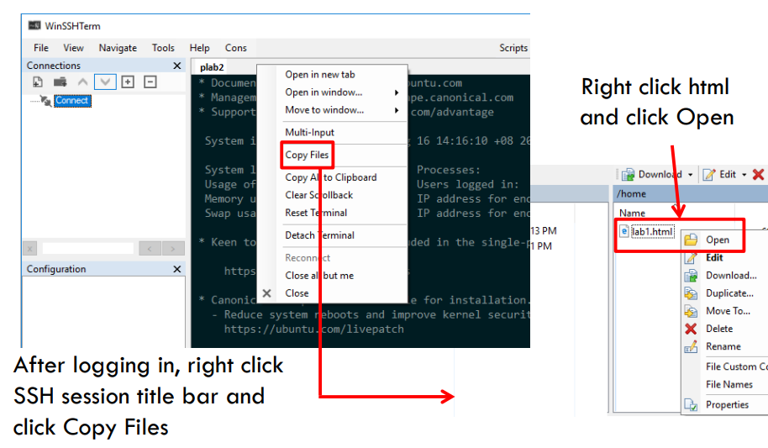
Viewing Questions

